Slide 1


Bike Sharing Demand Analysis Project Using Excel
By : Itisha Varma

Slide 2
Problem Statement
Analyzing bike-sharing data in order to understand how weather, time, and holidays affect bike rentals. Using Excel to clean, combine, and study datasets to find useful patterns that improve business planning.

Slide 3
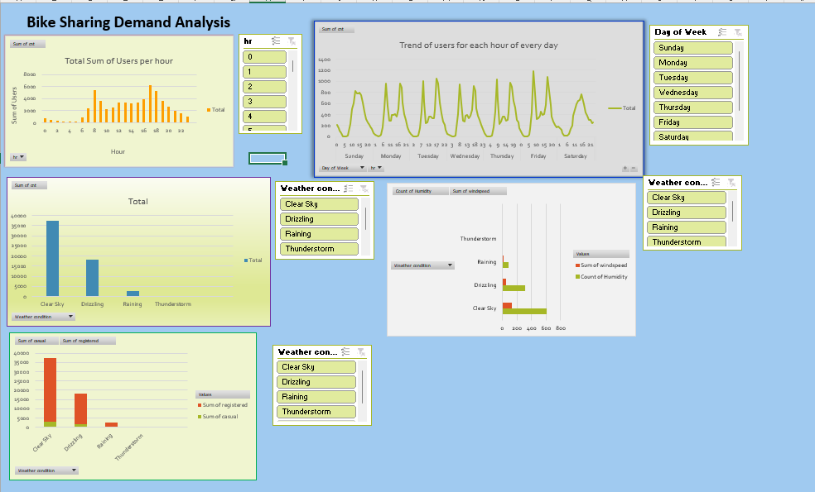
Solution
Dashboard : Shows all the trends and analysis for bike rentals

Slide 4
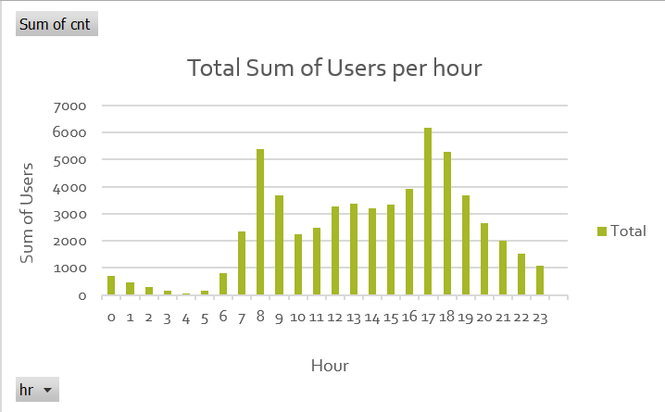
To check count of users per hour
Opinion : This chart tells us what is the sum of users(registered and casual) per
hour for renting bikes. Showing a trend as to what could be the future
predictions.

Slide 5
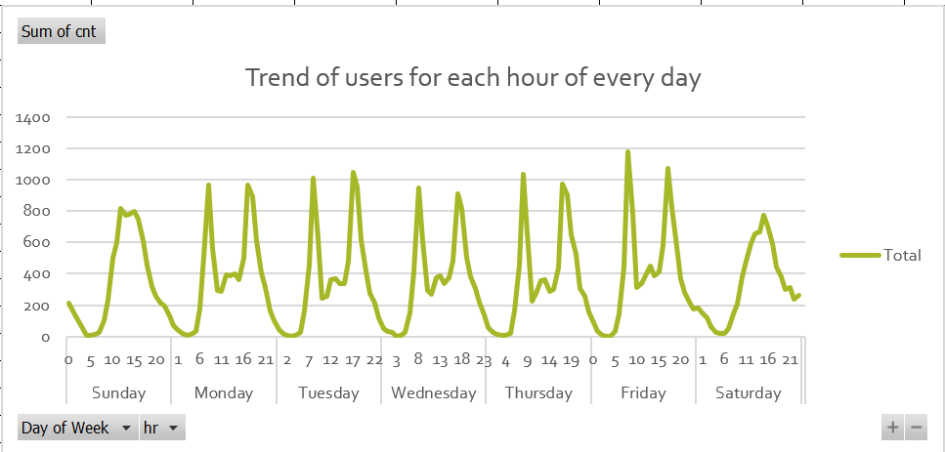
Trend of users for each hour of the every day
Opinion : This chart portrays a trend line for sum of users (registered and casual) per
hour for each day. Each day has been depicted based on the values given in
datasheet (0 to 6) taking 0 as Sunday and 6 as Saturday

Slide 6
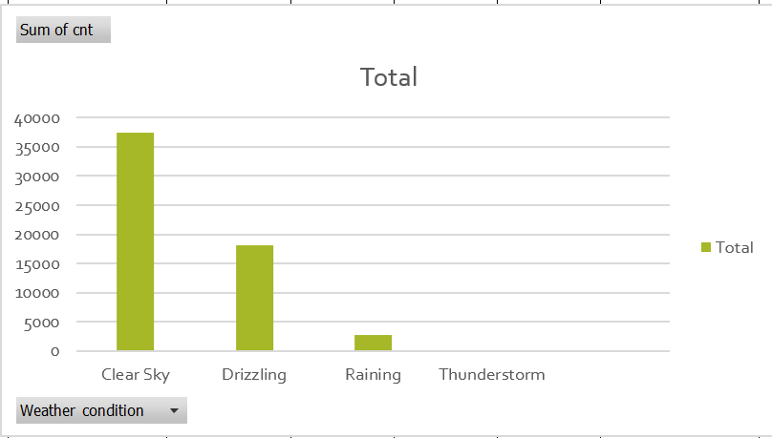
Users as per the weather condition
Opinion : This chart portrays a how based on weather conditions, users for bike rentals differ. Weather and windspeed are the vital factors for bike rental analysis

Slide 7
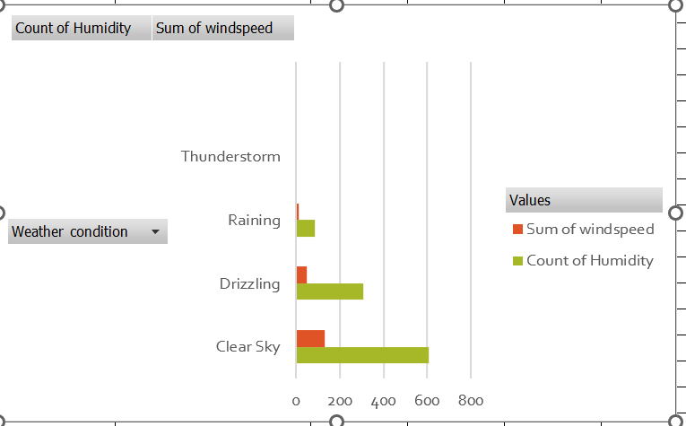
Humidity and windspeed based on weather condition
Opinion : This chart portrays a how based on humidity and windspeed conditions, users for bike rentals differ. Humidity and windspeed are the vital factors for bike rental analysis

Slide 8
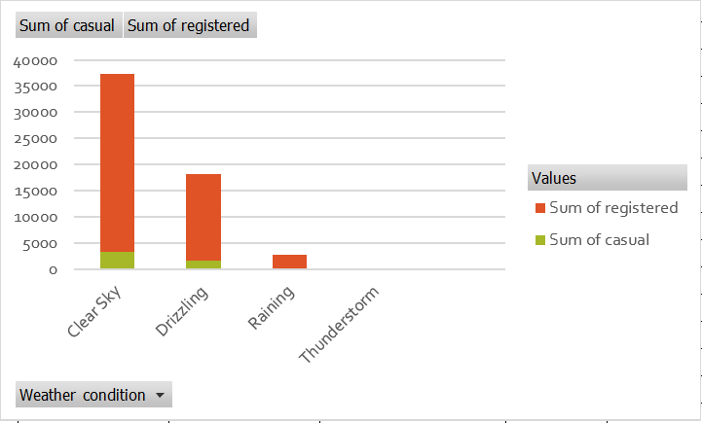
Type of Users based on weather conditions
Opinion : This chart portrays a how based weather conditions, users for bike rentals differ.

Slide 9
Merging Dataset 1, Dataset 2 based on “Instant” column.
Removing “Season” column from the merge data sheet because the value of it never changes.
Also “atemp” column has few blank values, filling them using isBlank() function
Then appending Dataset 3 using Power Query to get the final data values.
Step 1

Slide 10
Pre process the final merged data by removing duplicates and blanks using Conditional formatting feature of Excel.
Step 2

Slide 11
Step 3
Have analyzed the data and come up with few more columns using the functions of Excel like, SUM, AVERAGE, IF, IFS, AND, OR etc.

Slide 12
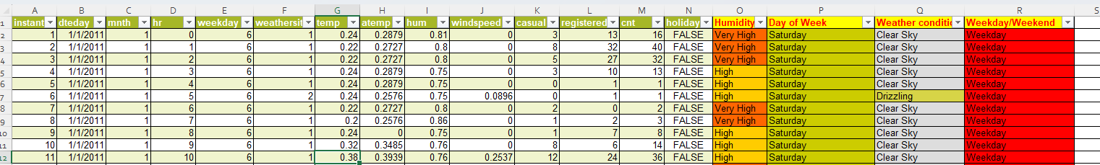
Final Dataset
Based on the “Weekday” column values, have created 2 more columns, “Day of the week” and “Weekday/Weekend”
Based on the “hum” column, have created another column “Humidity”
Based on “weathersit” column, have created one more column “Weather condition”

Slide 13
Step 4
Creating Pivot tables and pivot charts for better understanding of the analysis

Slide 14
Thank you!

